Slide 1





A Nationwide Census on WiFi Security Threats:
Prevalence, Riskiness, and the Economics
Di Gao, Hao Lin, Zhenhua Li, Feng Qian, Qi Alfred Chen
Zhiyun Qian, Wei Liu, Liangyi Gong, Yunhao Liu

Slide 2
Outline
1. Background
2. Methodology
3. Key Findings
4. Attack Ecosystem
5. Summary

Slide 3
Outline
1. Background
2. Methodology
3. Key Findings
4. Attack Ecosystem
5. Summary

Slide 4


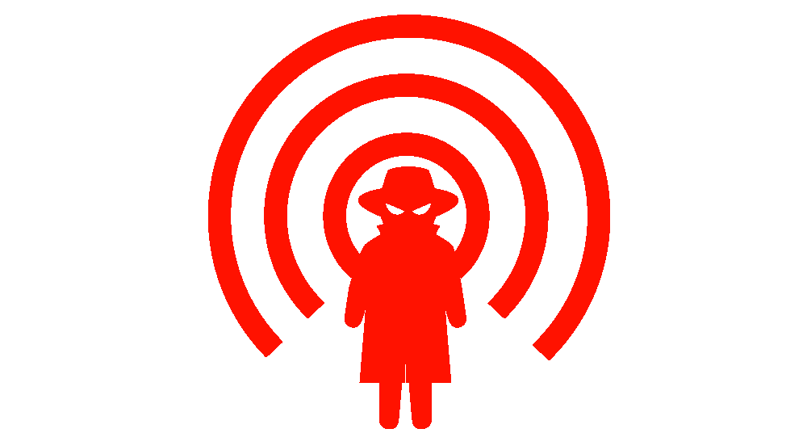
1.1 WiFi & Security Threats
WiFi: An Enticing Target for Security Threats
WiFi carries over 75% of the last-mile mobile Internet traffic
Vulnerabilities of WiFi access points (APs) have been exploited
Traffic eavesdropping
Phishing attack
Cryptojacking …
Various attack vectors in the wild
Compromised AP
Malicious AP

Slide 5
1.2 WiFi Security Today
WiFi-based Attacks: Nationwide Security Threats
Affecting Hundreds of Millions of End Users

Slide 6
Outline
1. Background
2. Methodology
3. Key Findings
4. Attack Ecosystem
5. Summary

Slide 7
2.1 Large-Scale Measurement
Collaborative Study
In collaboration with WiFiManager, a WiFi management service
WiFiManager serves 800M+ Android users in 200+ countries
User devices as testers for WiFi APs
WiSC: A WiFi Security Checking System inside WiFiManager
Requirements
Challenges
User-space App
No Root Access
In-depth Understanding
Good Coverage & Precision
Low Resource Consumption
No Long-Term Monitoring

Slide 8
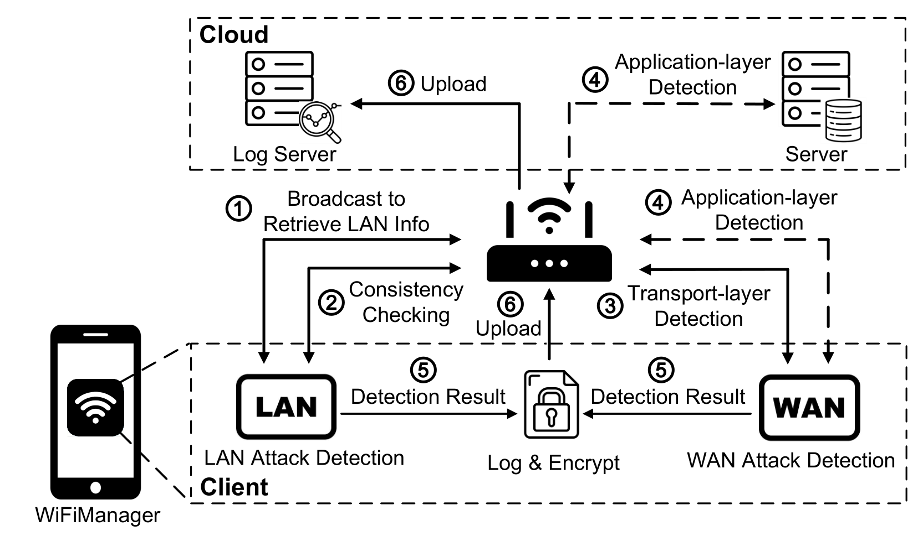
2.2 WiSC Architecture
System Overview: A Two-Stage Pipeline
First Stage: LAN Attack Detection
Second Stage: WAN Attack Detection

Slide 9
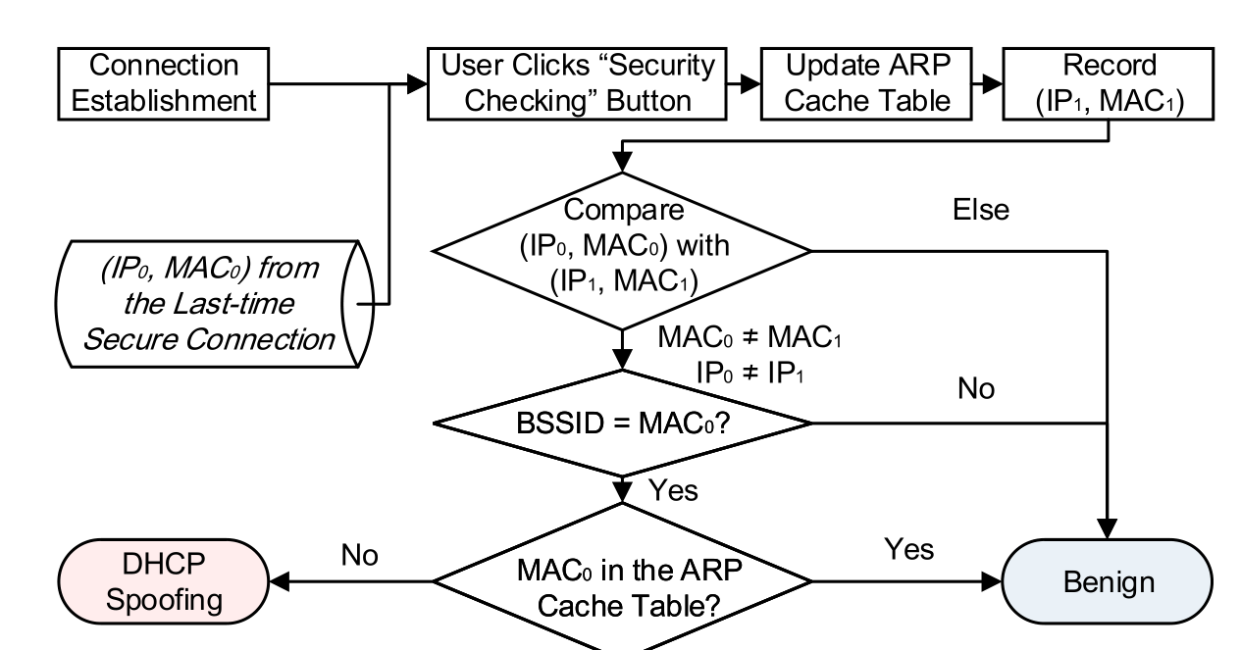
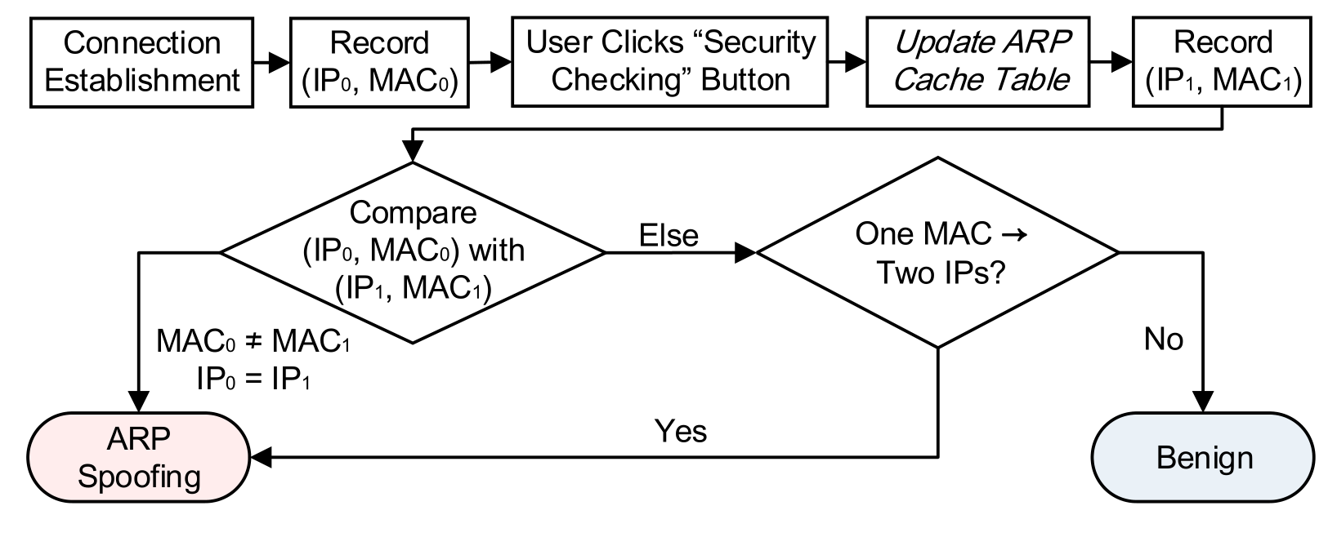
2.3 LAN Attack Detection
Cross-Connection Gateway-Consistency Detection
Threat model: ARP spoofing and DHCP spoofing
Broadcast ARP Requests to retrieve LAN info & configurations
Run consistency checking with cross-connection & historic data
ARP Spoofing Detection
DHCP Spoofing Detection
① Record Historic Data
② Consistency Checking
① Record Cross-Connection Data
② Consistency Checking
Rule out various false positives that traditional methods may fall into

Slide 10
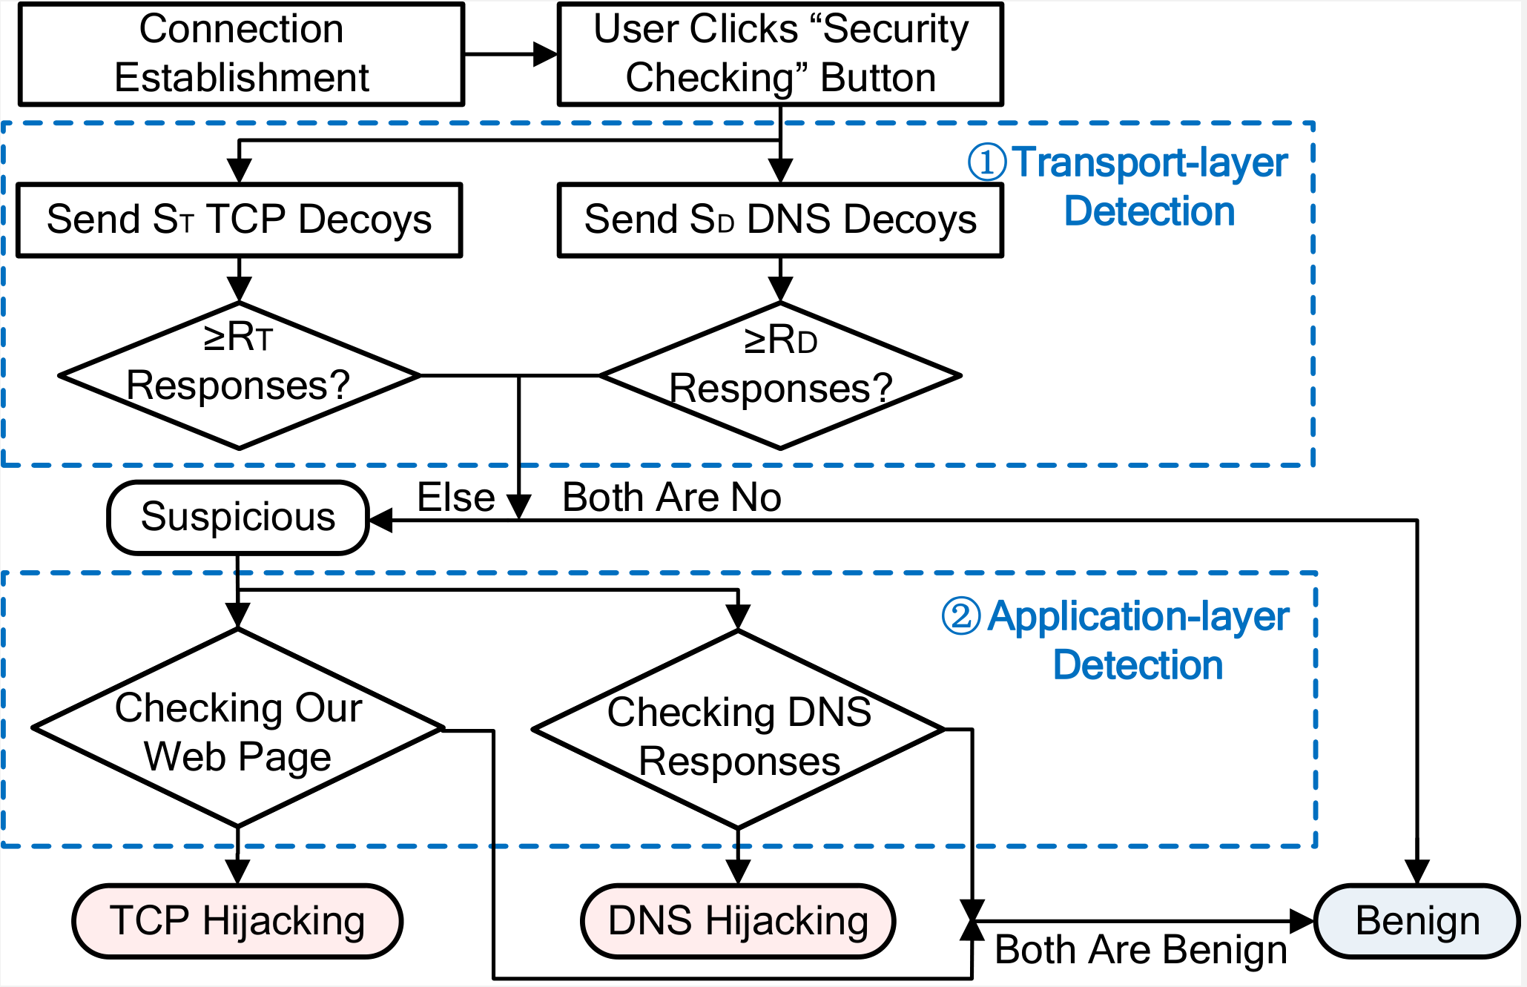
2.4 WAN Attack Detection
Cross-Layer Decoy-Based Detection
Thread Model: TCP hijacking and DNS hijacking
Transport-layer detection & application-layer detection

Slide 11
2.4 WAN Attack Detection
Transport-Layer Detection
Key insight: even packets with unreachable destination IP addresses are highly likely to trigger the hijacking behavior
Much Easier Than
Fabricate Spoofed Responses
Check Reachability
Packets with unreachable destination IP addresses
Send decoy packets to the WiFi AP and check response rate
Carrying web-like TCP/DNS traffic
Suspicious WiFi
Response Rate > Threshold R?
Else
No for both TCP & DNS
Benign WiFi
Threshold R is determined with data-driven statistical modeling

Slide 12
2.4 WAN Attack Detection
Application-Layer Detection
For the APs deemed as suspicious by transport-layer detection
Rule out false positives such as ISPs’ DNS interception
DNS hijacking detection
TCP hijacking detection
Check DNS Responses
Query for Crafted Web Page
If responses are irregular
Check Modifications & Planted Fingerprints
DNS hijacking
If modifications & fingerprints exist
TCP hijacking

Slide 13
2.5 Real-World Deployment
We implement WiSC as an optional function of WiFiManager
Users can opt in by clicking the “Security Checking” button
Period: From 10/22/2018 to 04/03/2019 (6 months)
Record a total of 14M opt-in users and 19M WiFi APs
Involve 178 countries/regions, mostly located in China

Slide 14
Outline
1. Background
2. Methodology
3. Key Findings
4. Attack Ecosystem
5. Summary

Slide 15
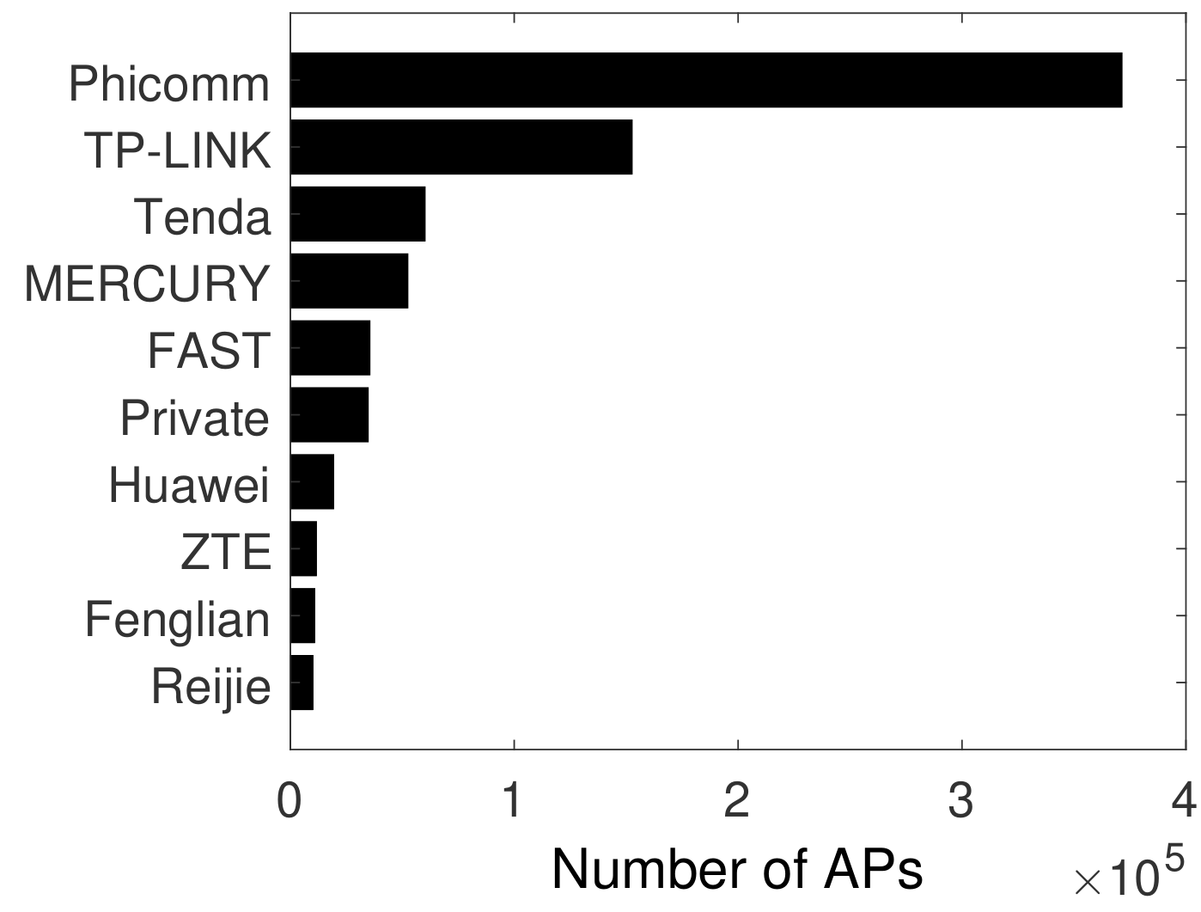
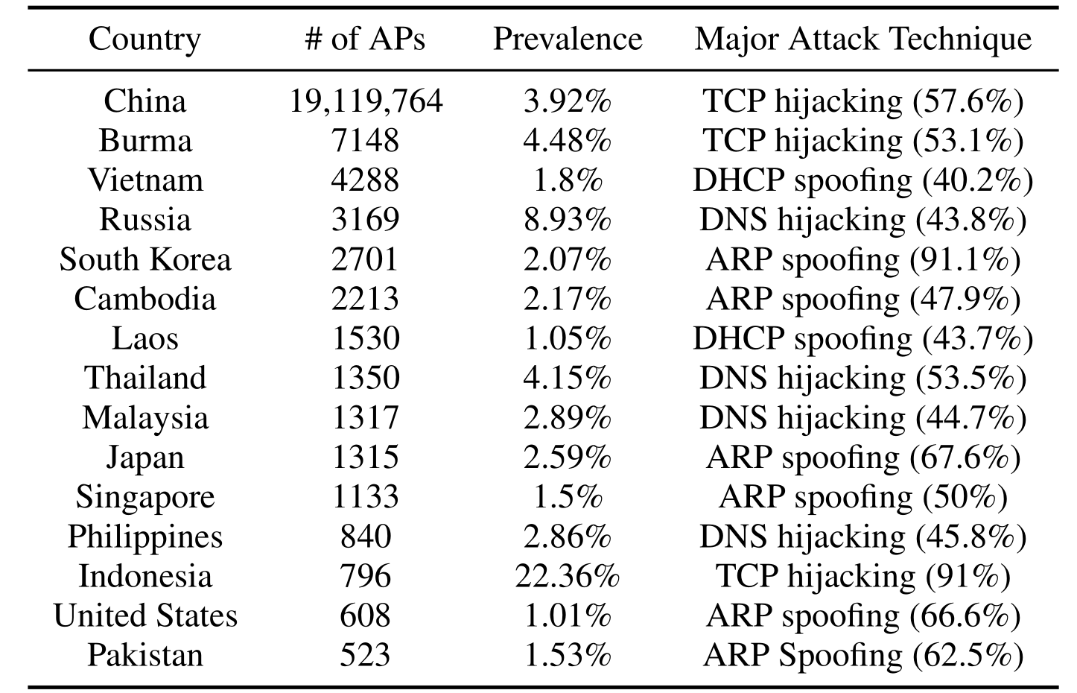
3.1 Prevalence of Attack
Attacks are detected on 3.92% of the APs (1.5% in previous study)
Among all the malicious APs, top 10 brands account for 98.48%
Some countries exhibit even higher prevalence of attacks than China

Slide 16
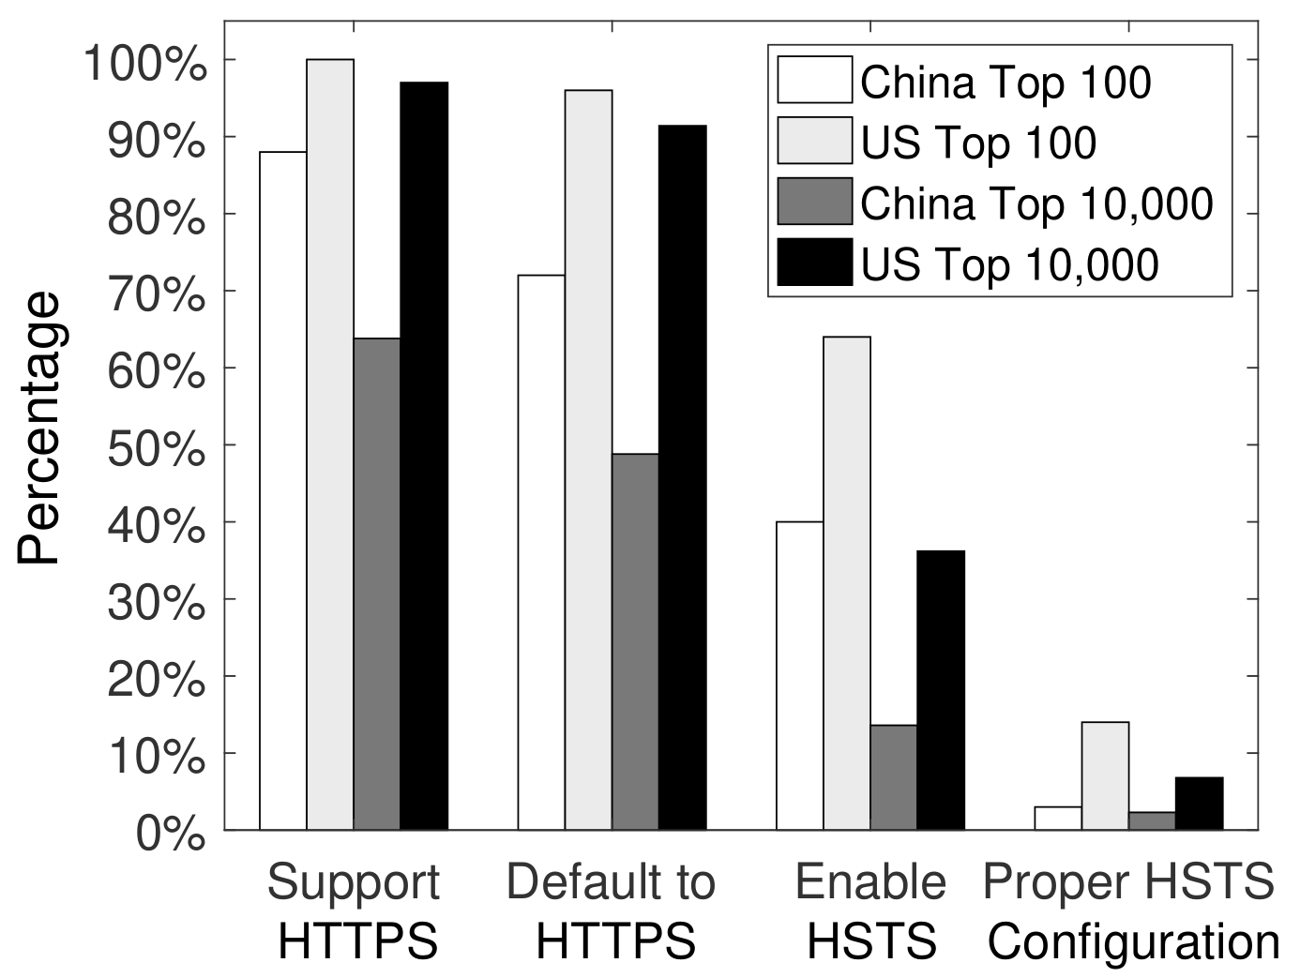
Attack Techniques | Ratio
TCP Hijacking | 57%
DNS Hijacking | 17%
ARP Spoofing | 16%
DHCP Spoofing | 12%
3.2 Attack Techniques (WAN)
TCP hijacking accounts for 57% of attacks
Why is TCP hijacking still rampant when there is HTTPS?
We measure HTTPS deployment for top Alexa ranking sites
A staggering lack of effective HTTPS adoption!
Quite a few do not use HTTPS by default
60% China & 36% US top 100 sites do not enable HSTS
92.5% China & 78.1% US top 100 sites do not properly configure HSTS

Slide 17
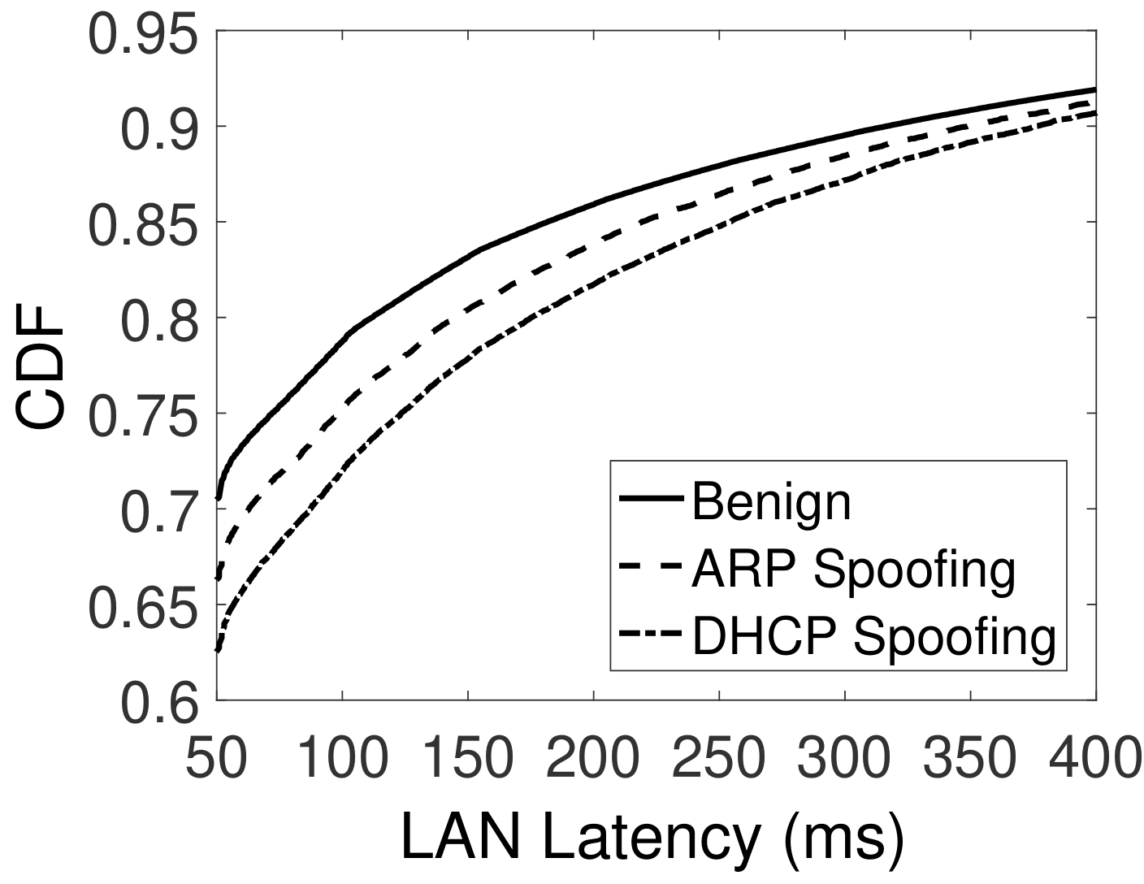
Attack Techniques | Ratio
TCP Hijacking | 57%
DNS Hijacking | 17%
ARP Spoofing | 16%
DHCP Spoofing | 12%
3.3 Attack Techniques (LAN)
DHCP spoofing was previously hypothetical
We make real-world observations of DHCP spoofing
Spoofing is more detected on APs with poorer LAN connectivity
Poor LAN environment can slow down legitimate responses’ delivery
Adversaries may adopt response flooding to increase success rate

Slide 18
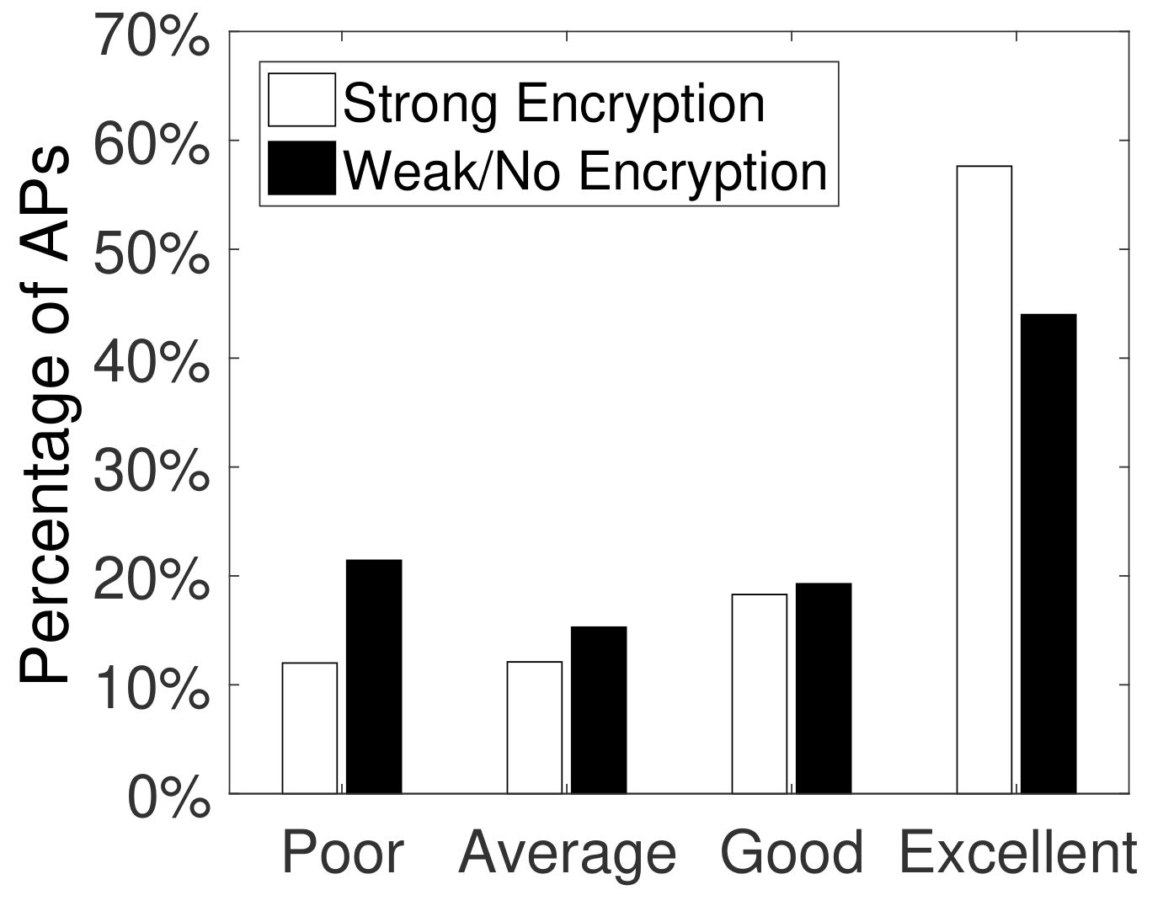
3.4 Malicious Behaviors & Objectives
55% of the attacks involve web pages being injected with ads
26% are typical DoS and passive traffic monitoring by spoofing
Potential phishing attacks through DNS hijacking
< 8%
HTTPS-targeted attacks such as SSLStrip are identified
Ad injection is detected on
Better encryption seems to aggravate the problem?
2.33% APs with strong encryption (WPA/WPA2)
1% APs with no or weak encryption (WEP)
Strong encryption leads to better Internet connectivity, and thus higher success rate
Solely relying on link-layer cryptography may not suffice

Slide 19
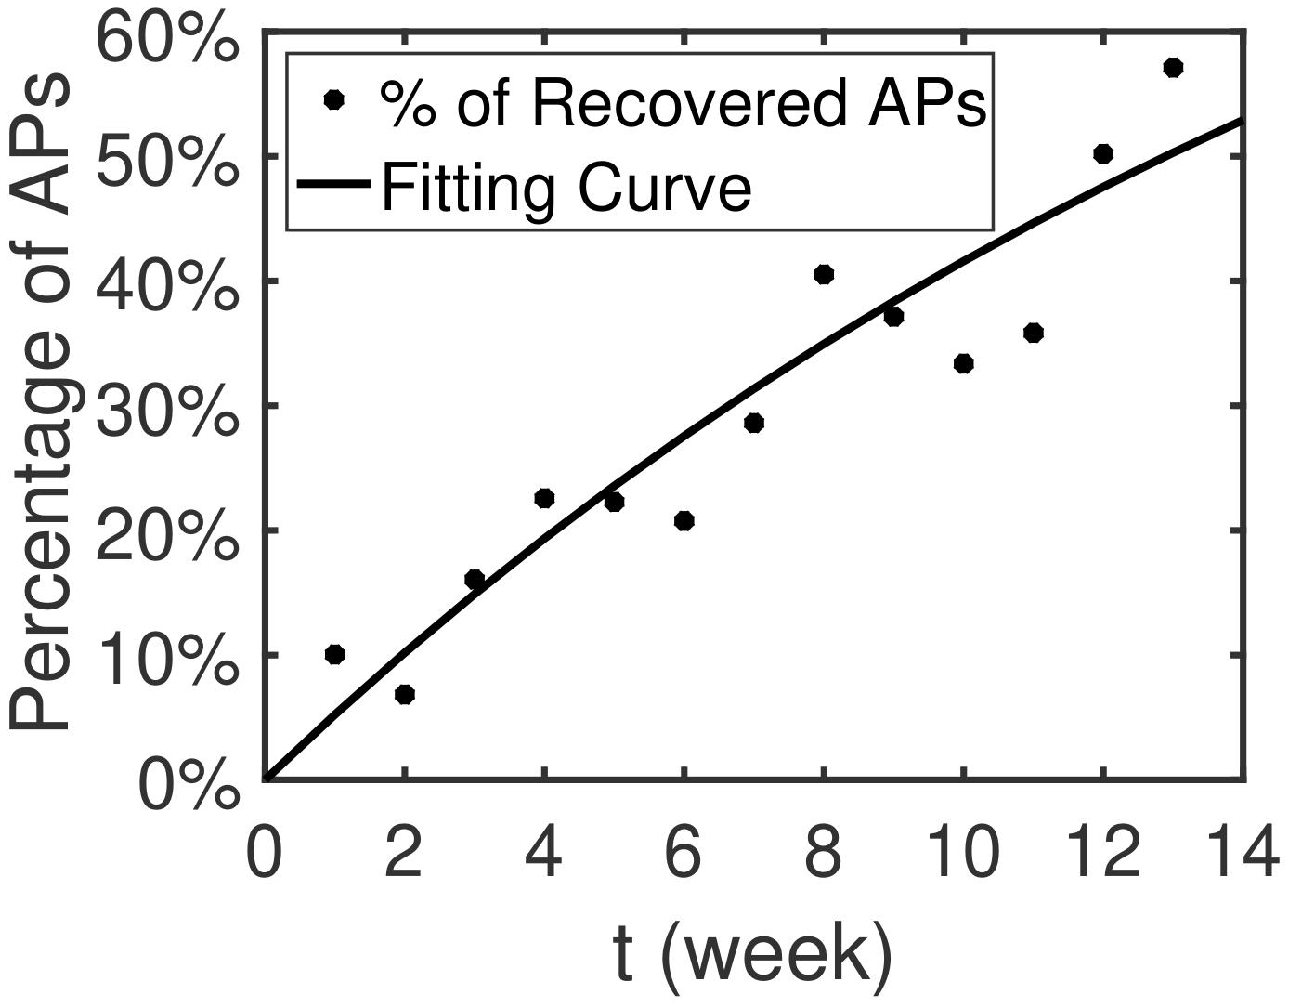
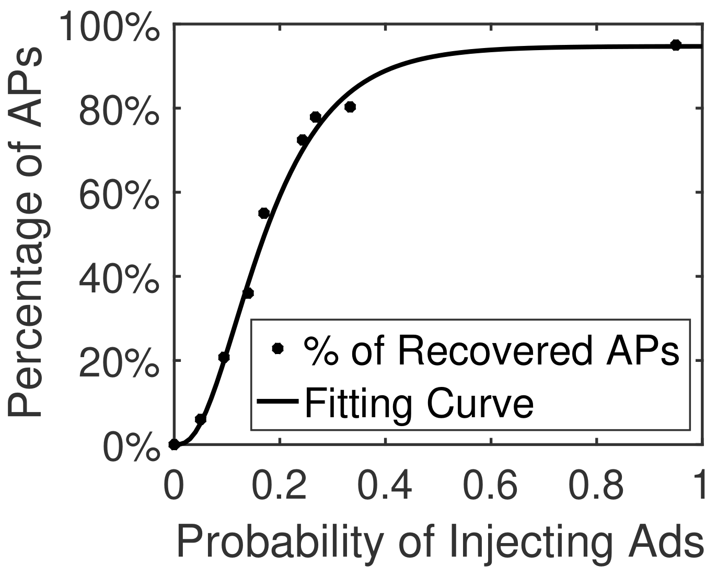

3.5 Fundamental Motives of Ad Injection
Evasive techniques are adopted (domain altering, code obfuscation)
A malicious AP does not compromise all intercepted web pages!
We analytically model the economy behind ad-injection attacks
?
Ad injection probability Pad
Ad injection profit Profit(Pad)
Key insight: malicious APs can gradually recover over time
Unintentional recovery
Intentional recovery

Slide 20
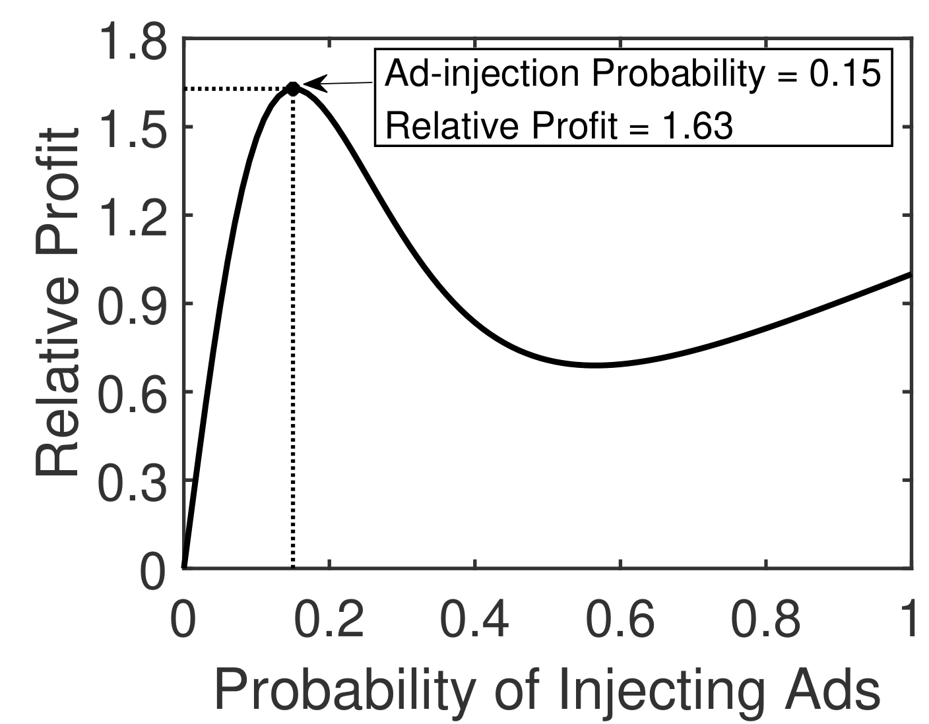
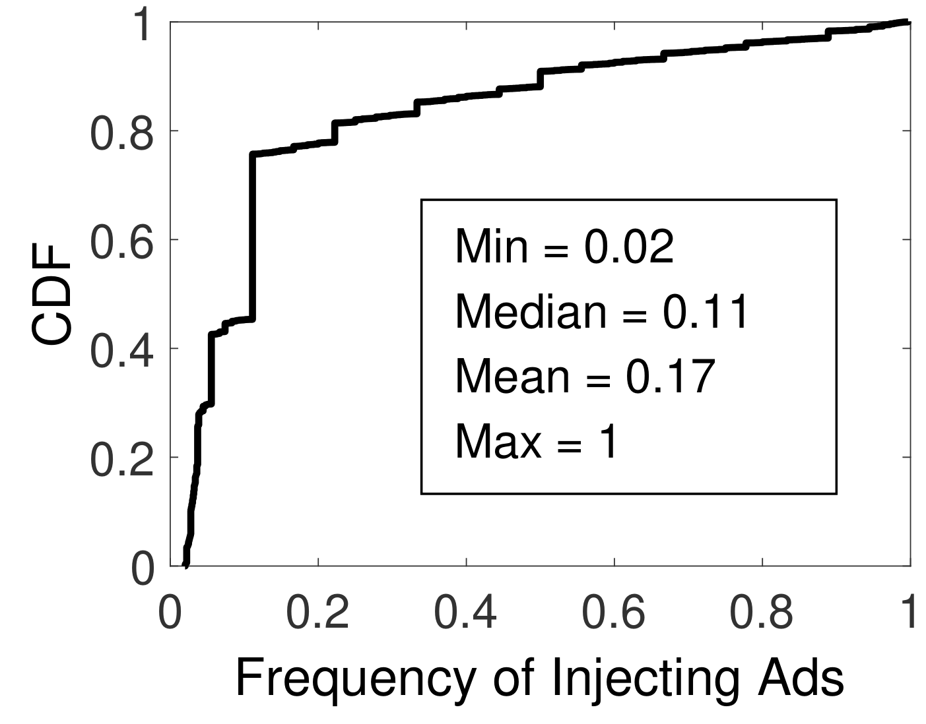
3.5 Fundamental Motives of Ad Injection
With the recovery probability of malicious APs:
Recovery probability
Number of malicious APs
Estimated profit
Estimated profit
Maximized at Pad = 0.15
Very close!
Actual injection probability
Averaging at Pad = 0.17
Adversaries may have carefully tuned their behaviors
to achieve maximum profit in the long run

Slide 21
Outline
1. Background
2. Methodology
3. Key Findings
4. Attack Ecosystem
5. Summary

Slide 22
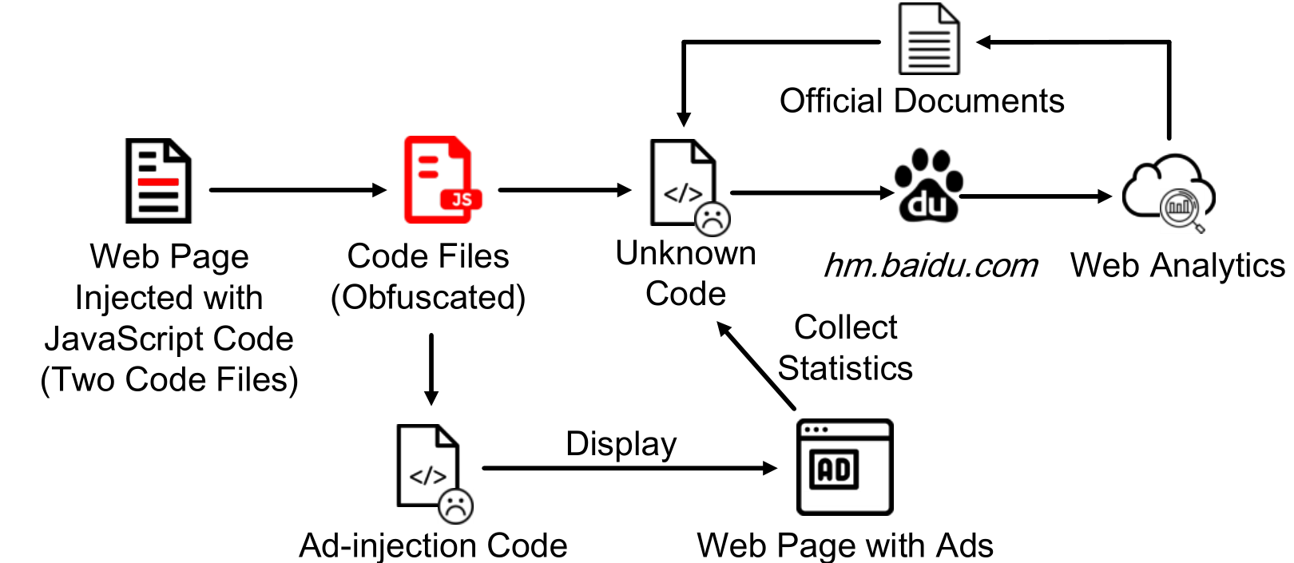
4.1 Uncovering the Ecosystem
We examine adversaries’ code inserted into the web page
Injection code consists of two components
e.g., hm.baidu.com
Web analytics service!
Code for injecting ads
Code from legitimate domains?
Adversaries use web analytics service to prove their advertising effects!

Slide 23
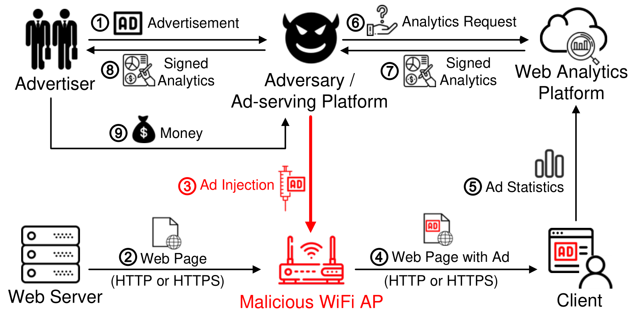
4.1 Uncovering the Ecosystem
Adversaries act as ad-serving platforms
Advertisers outsource advertising to these platforms
Ad-serving platforms inject ads through malicious APs
Ad-serving platforms prove advertising effects to advertisers
Done through legitimate analytics services

Slide 24
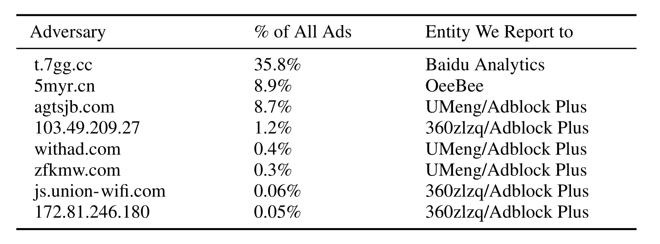
4.2 Undermining the Ecosystem
Adversaries heavily rely on web analytics platforms for monetization
Web analytics platforms are the bottleneck of the ecosystem!
We have reported our findings to the four identified platforms
Baidu Analytics stopped serving 67% of the reported ad links, leading to 49.8% of decrease of ad injections as of August 2020

Slide 25
5 Conclusion
We conduct the first large-scale measurement study of WiFi security threats of 19M WiFi APs based on 14M end user devices.
We present a lightweight WiFi threat detection system called WiSC that takes advantage of active probing and cross-layer information.
We comprehensively analyze WiFi attacks in the wild, the adversaries’ profit-driven motives, the WiFi attack ecosystem.
We discover that the web analytics platforms are the bottleneck of the underground economy and leverage it to effectively combat the preponderant ad injection attacks at the national scale.

